Slide 1
3rd Iteration
Client: Fred Sieling
Andres Almaraz and David Luis Hiraldo-Panchana

Slide 2
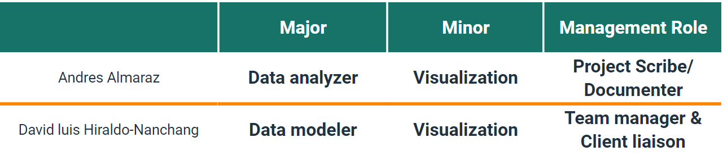
Roles

Slide 3









Technologies

Slide 4
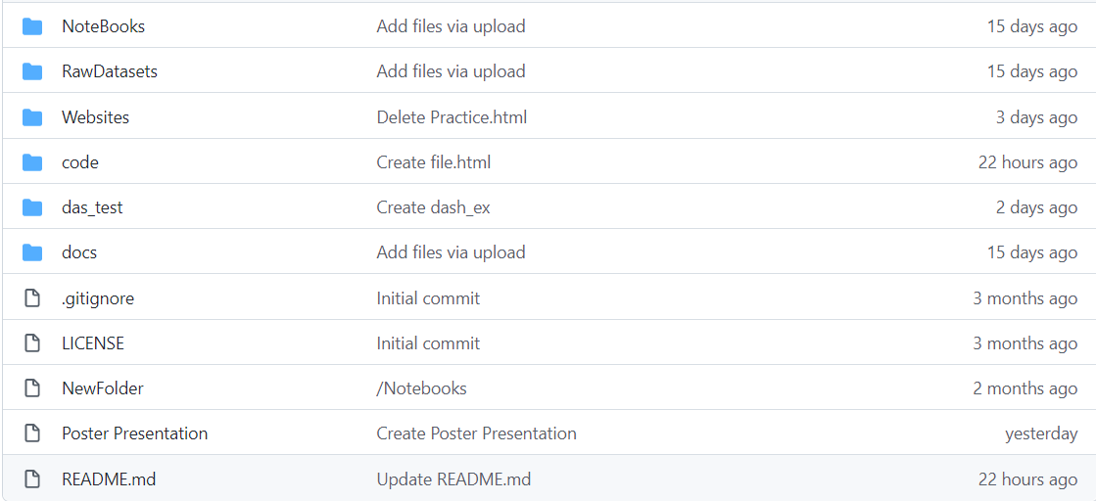
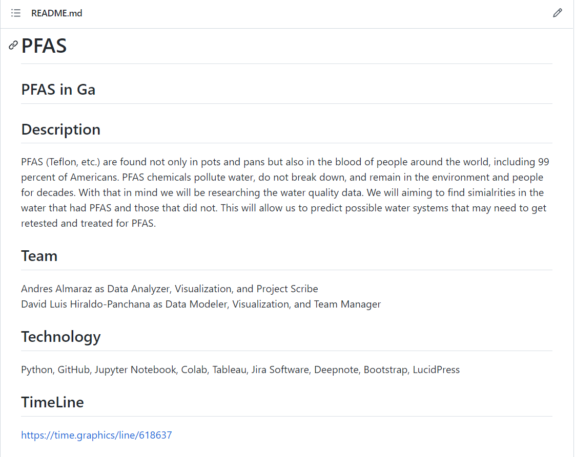
Github repo
Our updated Github, with all of information, link to website, documents, our notebooks and our datasets. The readme goes into more depth of our project and our purpose, our teams and some of the technologies we used.

Slide 5
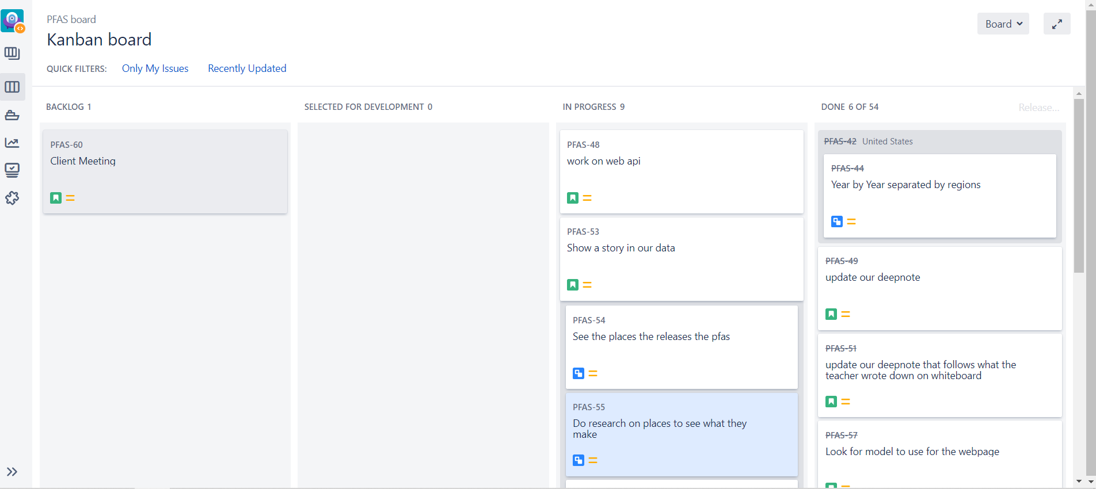
Jira
This is our progress shown in Jira, we have nearly completed all remaining tasks left. After the CREATE all that would be left is the client meeting.

Slide 6
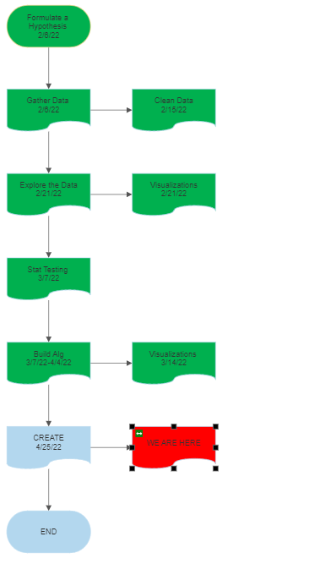
FlowChart
The final flowchart that shows where we are at currently. We are at CREATE and using all the remaining time to work on tasks needed for CREATE and after.

Slide 7
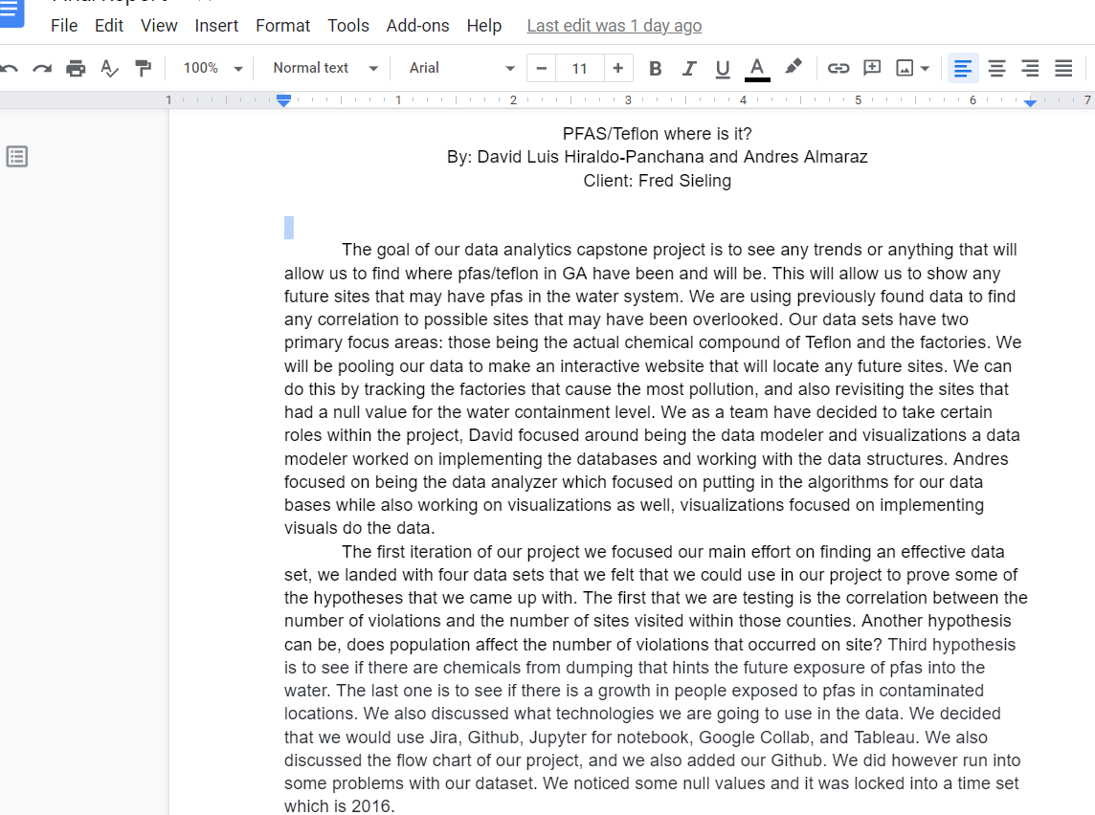
Brief Abstract
Our goal was to find trends that will allow us to find PFAS/Teflon in GA. The reasons being that it can cause serious health issues if entering a person's blood system. Since the chemical never fully goes away, it stays once anyone is exposed to it. So we want to be able indicate/reveal PFAS at any site to prevent harm and find the offenders causing it.
Link to Final Report

Slide 8
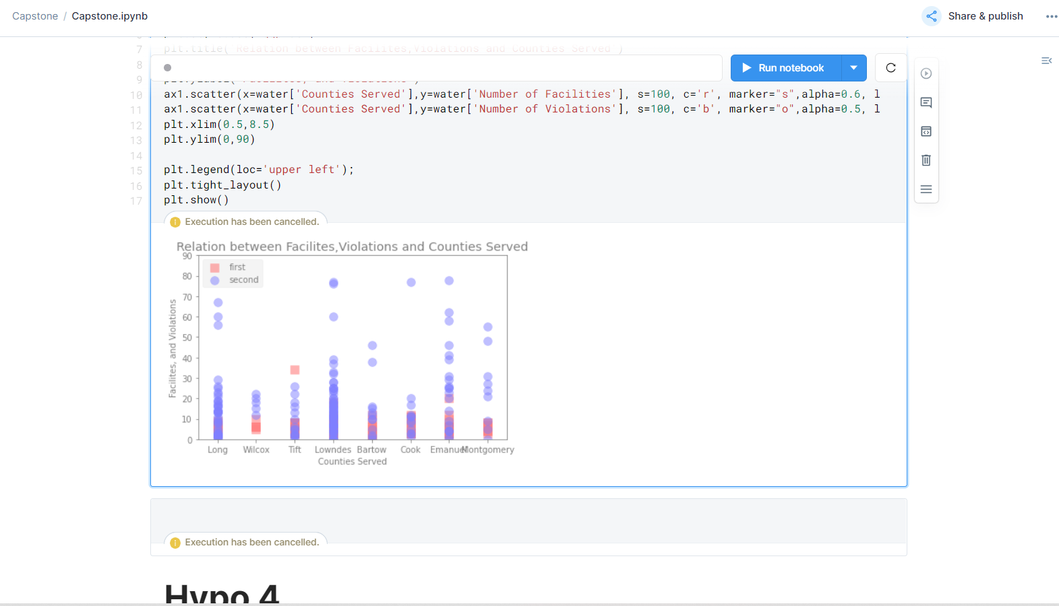
Updated Deep note
This is an updated version of our deep note, it shows more in depth version of our hypothesis. It has new visualizations and our abstract in it.

Slide 9
Implemented
Only the first three hypothesis were implemented
Website with interactive map and information about PFAS that we learned
We implemented two algorithms being clustering and linear regression
Visualizations to support the hypothesis was done
Research on sites with PFAS and the cause at the time it happened

Slide 10
TO DO
Implement a fourth hypothesis.
Find current datasets to support our argument
Dig deeper into what the industries causing the issues produced
Could focus on other states and their counties as well to found out if they had any similarities to Georgia
Use more algorithms as well to predict future sights of PFAS using the correlations that were found

Slide 11
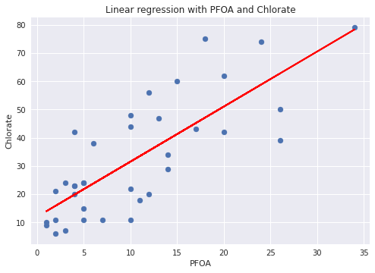
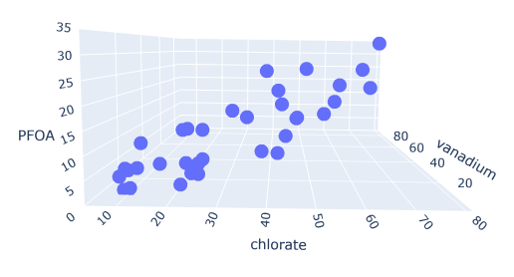
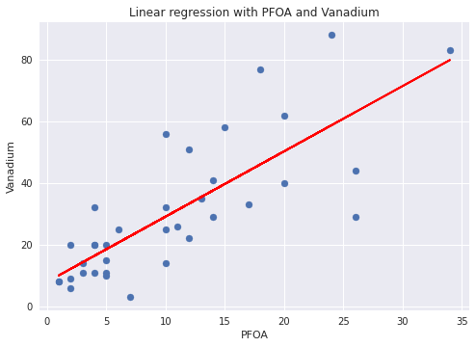
Hypothesis 1
Seeing if there is an indicator that can be used in finding PFAS in the water

Slide 12
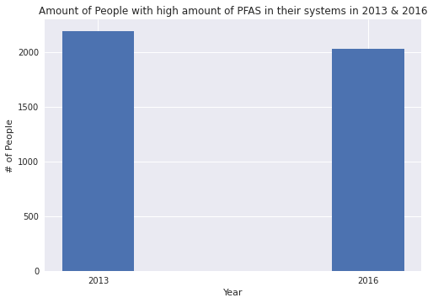
Hypothesis 2
See if there is a growth in people exposed to pfas in 2013 and 2016

Slide 13
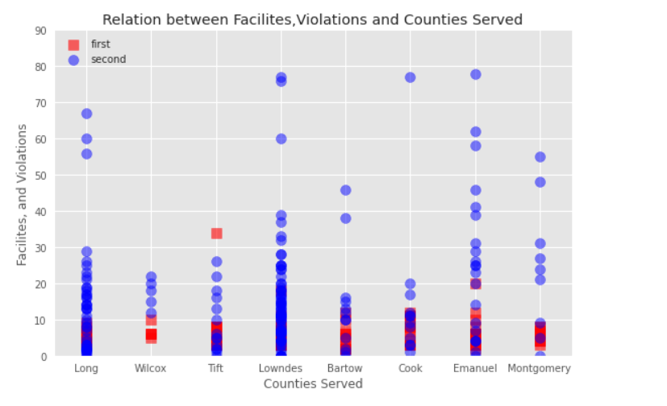
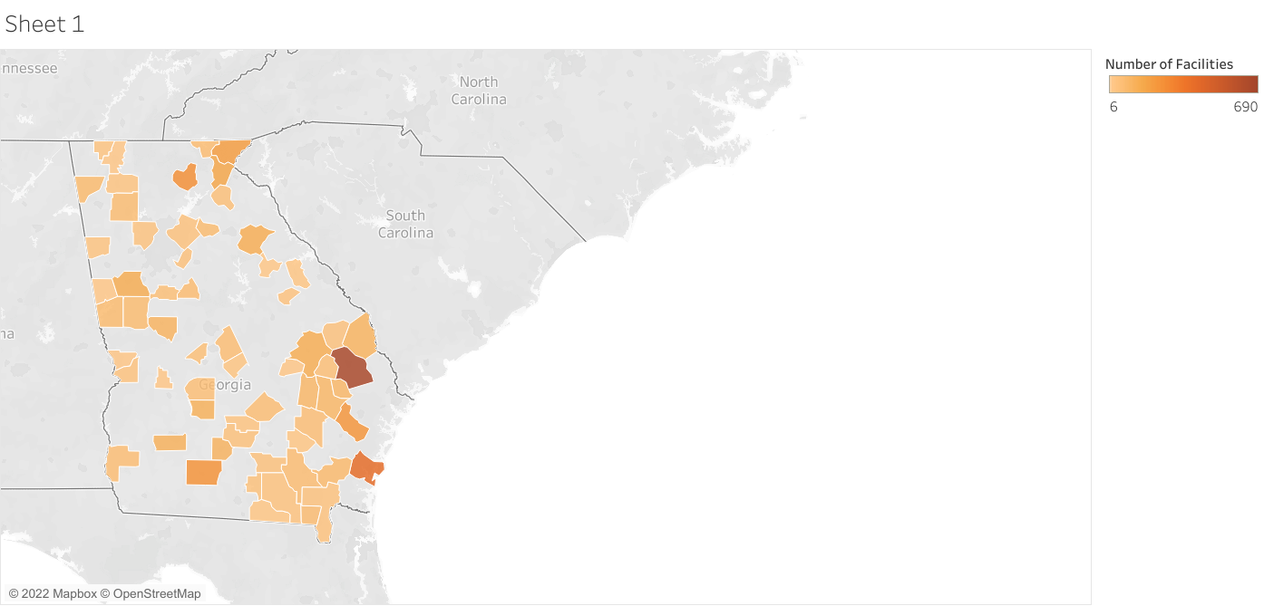
Extended graphs for Hypo 3

Slide 14
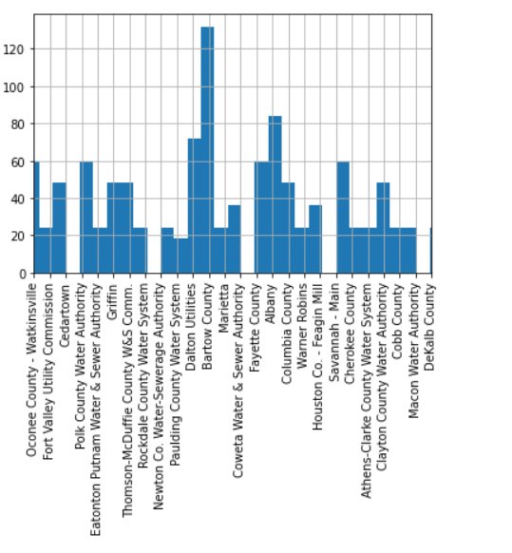
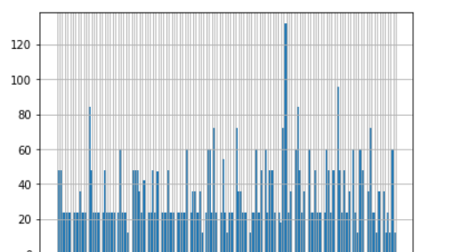
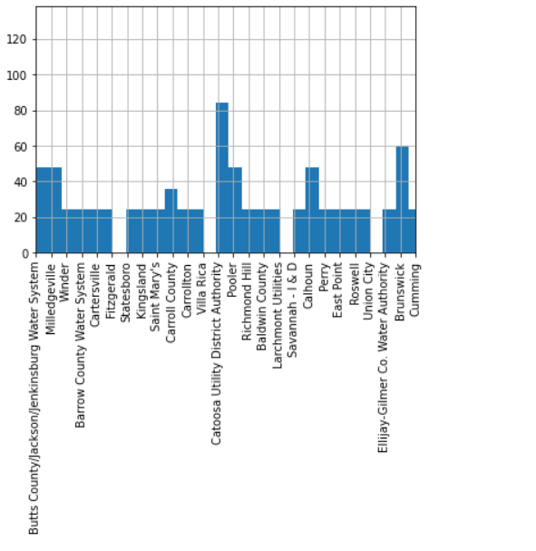
Hypothesis 4
To see where the most traces of pfas occurred within the state of GA

Slide 15
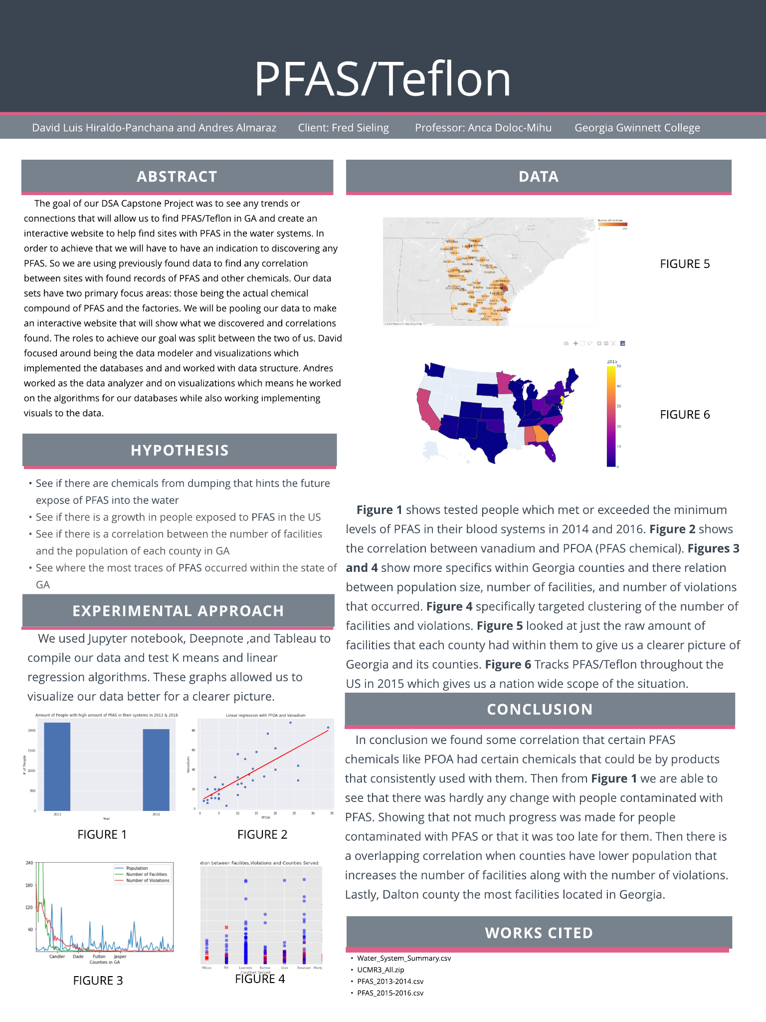
Poster

Slide 16
